Slide 1




The Nagoya Protocol and the ITPGRFA: practical implications for plant breeders
Martin Brink (ABS National Focal Point, the Netherlands)
16 April 2025

Slide 2



The Nagoya Protocol and the ITPGRFA: practical implications for plant breeders
Nagoya Protocol
International Treaty on Plant Genetic Resources for Food and Agriculture (ITPGRFA)
Implementation
Practical implications
National Focal Point

Slide 3
The Nagoya Protocol and the ITPGRFA: practical implications for plant breeders
Nagoya Protocol
International Treaty on Plant Genetic Resources for Food and Agriculture (ITPGRFA)
Implementation
Practical implications
National Focal Point

Slide 4


The Nagoya Protocol
Scope
  Genetic Resources
    any material of plant, animal, microbial or other origin containing functional units of heredity, that is of actual or potential value
    except for human genetic resources
Principles
  Provider countries are to ensure clear and transparent procedures
  compliance to ABS rules in provider countries is to be monitored by the countries where the genetic resources are utilized

Slide 5

The Nagoya Protocol
Access on the basis of
  Prior Informed Consent (PIC): permission by authorities of the country providing genetic resources
    unless otherwise determined by that country
  Mutually Agreed Terms (MAT): contract with provider
    so, bilateral negotiations are necessary
Benefit-sharing
  benefits can be monetary (e.g. royalties, up-front payments) and non-monetary (e.g. co-operation, technology transfer)
  to be bilaterally agreed (in Mutually Agreed Terms)

Slide 6
The Nagoya Protocol and the ITPGRFA: practical implications for plant breeders
Nagoya Protocol
International Treaty on Plant Genetic Resources for Food and Agriculture (ITPGRFA)
Implementation
Practical implications
National Focal Point

Slide 7
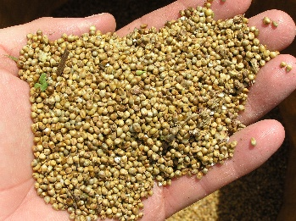
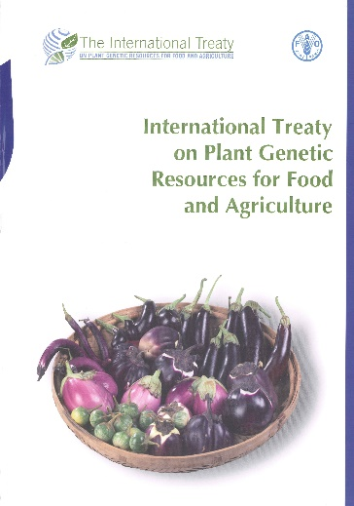
International Treaty on Plant Genetic Resources for Food and Agriculture (ITPGRFA)
Scope
  Plant Genetic Resources for Food and Agriculture (PGRFA)
    any genetic material of plant origin of actual or potential value for food and agriculture
Principles
  ABS forms only part of ITPGRFA; also deals with conservation and sustainable use of PGRFA
  ABS goals to be achieved through a Multilateral System (MLS) of exchange of genetic resources
  Annex 1: list of crops (35 food crops, 29 forages) covered under the MLS
    no ornamentals

Slide 8

International Treaty on Plant Genetic Resources for Food and Agriculture (ITPGRFA)
Access to MLS material
  on the basis of Standard Material Transfer Agreement (SMTA)
    so no bilateral negotiations necessary
  SMTA only for research, breeding and training for food and agriculture
Benefit-sharing
  benefits include non-monetary benefits (access to PGRFA, exchange of information, access to and transfer of technology, capacity-building) and monetary benefits
  monetary benefit-sharing (currently) only mandatory if product is not available without restriction
  monetary benefits placed into an International Benefit-Sharing Fund, to be used for projects in developing countries
Some countries also make non-MLS material available under the SMTA

Slide 9
The Nagoya Protocol and the ITPGRFA: practical implications for plant breeders
Nagoya Protocol
International Treaty on Plant Genetic Resources for Food and Agriculture (ITPGRFA)
Implementation
Practical implications
National Focal Point

Slide 10

Implementation Nagoya Protocol in EU
EU
  The EU ABS Regulation (Regulation (EU) 511/2014)
    published in 2014
    legally binding (law)
    gives obligations for users and governments EU countries
  Implementing Regulation (EU) 2015/1866
    published in 2015
    legally binding
    gives more detailed rules on the implementation of certain articles of the EU ABS Regulation
  Guidance document
    published in 2016; revised 2021
    gives explanations, not legally binding

Slide 11
The EU ABS Regulation (Regulation (EU) 511/2014)
Implements compliance aspects of the Nagoya Protocol in the EU
  only deals with compliance, NOT with access
  access regulated by individual countries, not at EU level
Entry into force: 12 October 2014
  Applies to genetic resources
    accessed from 12 October 2014 onwards
    accessed from a country that is a Party to the Nagoya Protocol and has established access measures
    utilised in R&D within the EU (commercial and non-commercial)
  Legally binding for all companies, institutions and individuals within the EU

Slide 12

The EU ABS Regulation:
User obligations
  To exercise ‘due diligence’ to ascertain that the genetic resources (and associated traditional knowledge) they utilise have been legally acquired, and that benefits are shared
  To utilise and transfer genetic resources in accordance with the MAT (Mutually Agreed Terms)
  Therefore:
    seek relevant ABS information
    obtain required permits and contracts
    keep ABS information for 20 years after end utilisation
    transfer relevant ABS information to subsequent users

Slide 13
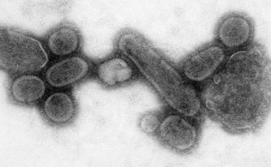
The EU ABS Regulation:
Specialised International Instruments
  The EU ABS Regulation does not apply when ABS of genetic resources is covered by a ‘Specialised International Instrument’ (Art. 2)
  Instruments recognized by the EU:
    International Treaty on Plant Genetic Resources for Food and Agriculture (ITPGRFA)
      plant genetic resources for food and agriculture
    Pandemic Influenza Preparedness Framework (PIP-framework)
      influenza viruses with human pandemic potential

Slide 14

EU Guidance Document
First version 2016; revised version 2021
Not legally binding; explains EU ABS Regulation
Explanation ‘utilisation’ = basic research, applied research and/or product development
  if an activity creates new insight into characteristics of the genetic resource which is of (potential) benefit to the further process of product development, it falls under the term ‘utilisation’
Two main parts
  Main text
  Annex 2

Slide 15

EU Guidance Document: Main text
  Introduction
  Scope of the EU ABS Regulation
  Obligations of users
    due diligence obligation
    specific situations
  Events triggering due diligence declarations
    external research funding
    final development of product
  Sector specific issues
    health
    food and agriculture

Slide 16
EU Guidance Document: Section 5.1
  not in scope of the EU ABS Regulation:
    PGRFA covered by Annex I, included in the Multilateral System (MLS) of the ITPGRFA and obtained from ITPGRFA Parties
    PGRFA received under an SMTA from third persons/entities who themselves received them under an SMTA from the MLS
    PGRFA received under an SMTA from International Agricultural Research Centres such as those of the Consultative Group on International Agricultural Research (CGIAR)
  within scope of the EU ABS Regulation but due diligence obligation considered complied with
    Non-Annex I PGRFA supplied under the terms of the SMTA if a Party to the Nagoya Protocol has determined that its PGRFA will also be subject to the SMTA

Slide 17

EU Guidance Document: Annex II
  Provides specific guidance on when genetic resources are considered to be utilised in the meaning of the EU ABS Regulation (assuming they fall in the geographical, temporal and material scopes)
  Follows logic of the value chain, starting from acquisition to placing of a product on a market
  Contains many examples (cases) drawn from different sectors, often based on feedback from stakeholders

Slide 18

EU Guidance Document: Annex 2
  Introduction
  Acquisition
  Storage and collection management
  Rearing and multiplication
  Exchange and transfer
  Identification of organisms and other activities at the beginning of the value chain
  Genetic resources as tools
  Breeding
  Product development, processing and product formulation
  Product testing
  Marketing and application

Slide 19
The Nagoya Protocol and the ITPGRFA: practical implications for plant breeders
Nagoya Protocol
International Treaty on Plant Genetic Resources for Food and Agriculture (ITPGRFA)
Implementation
Practical implications
National Focal Point

Slide 20

What to do as a user?
  Check the access rules of the provider country
    ABS Clearing House (https://absch.cbd.int/)
    National Focal Point (NFP) of the provider country
  Check if the material can be obtained through the MLS of the ITPGRFA (Annex 1 crops and forages).
    If yes, sign a Standard Material Transfer agreement (SMTA)
    If no, continue with 3
  Check if the provider makes non-Annex 1 material available under the SMTA
    If yes, sign a Standard Material Transfer agreement (SMTA)
    If no, continue with 4
  If required, seek permission from the Competent National Authority (CNA) of the provider country (PIC: ‘Prior Informed Consent’)

Slide 21
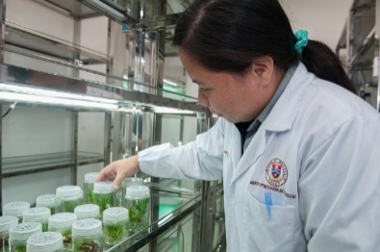
What to do as a user?
  Negotiate conditions with provider, and lay these down in a contract (MAT: ‘Mutually Agreed Terms’)
  Use the genetic resources only in accordance with the conditions agreed with the provider and laid down in the MAT
    if the intended use changes, new PIC and MAT may need to be obtained
  Carefully document the use
  Keep all documentation for 20 years after the end of utilisation
  Submit a ‘due diligence declaration’ (through https://webgate.ec.europa.eu/declare/) when you
    receive external research funding, or
    bring a product on the market
  Pass on information to further users of the genetic resources

Slide 22
Special case: companies with several entities
  EU Guidance document
    “If a company commercialises in the EU a product (…) where the utilisation (thus the entire process of research and development) took place outside of the EU, this is not covered by the EU ABS Regulation”
  Companies with several entities not specifically addressed in EU Regulations and Guidance document
  But in relation to due diligence declarations, EU Guidance document says:
    “Transfers between entities of the same company are not considered as transfer in the meaning of Article 6(2)(d) and 6(2)(e) of the Implementing Regulation, therefore filing of a due diligence declaration is not required”
  .

Slide 23
The Nagoya Protocol and the ITPGRFA: practical implications for plant breeders
Nagoya Protocol
International Treaty on Plant Genetic Resources for Food and Agriculture (ITPGRFA)
Implementation
Practical implications
National Focal Point

Slide 24

NL National Focal Point on ABS
Website (www.absfocalpoint.nl)
  bilingual (Dutch/English)
  information on international ABS instruments (including Nagoya Protocol and ITPGRFA)
  information on EU ABS Regulation
  practical information on what to do
  interactive help tool
  news articles on specific issues and new developments (e.g. DSI)
  FAQ
ABS newsletter (subscription through website)
Presentations on request
Helpdesk
  send your questions to NagoyaNL@wur.nl

Slide 25

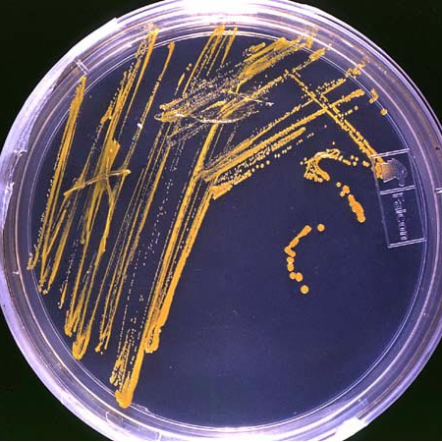
Thank you for your attention!
www.absfocalpoint.nl
NagoyaNL@wur.nl

